Slide 1
Product Description
Style Barber
Virtual Queue System using Python,Django

Slide 2
Overview
The product focuses on the Virtual Queue Management System which makes the users to make appointments for a saloon for any time slot available. Then the customers will receive a confirmation mail and a Whatsapp message where the customers can interact with it. The customers can save their valuable time by being in the virtual queue and arrive at the time selected.

Slide 3
Working of Application
The customer can make appointment from the main page directly to a form.
The user needs to fill up for registration, and select date and time-slot available.

Slide 4
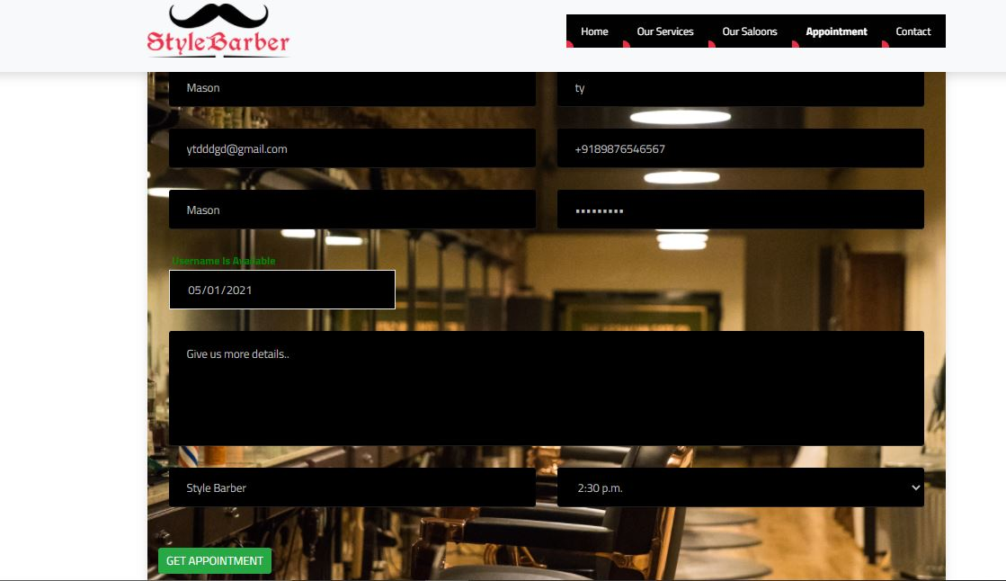

Slide 5
Working of Application
After the registration is completed a Whatsapp message and an Email will be received by user. This is an automated process.

Slide 6
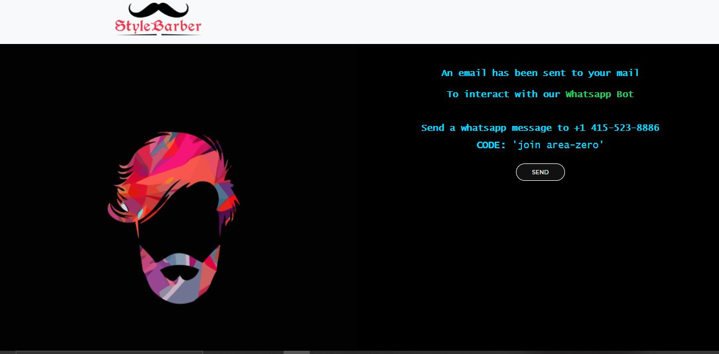

Slide 7
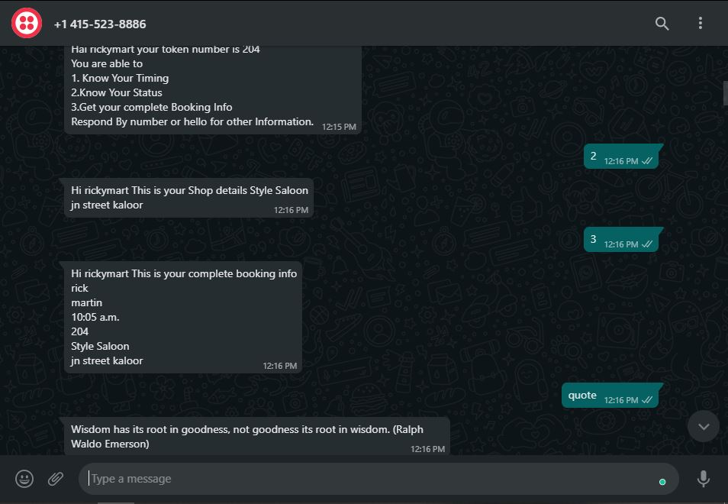

Slide 8
Working of Application
The user dashboard has details of appointment and an option for canceling the appointment and rescheduling their current appointment.

Slide 9
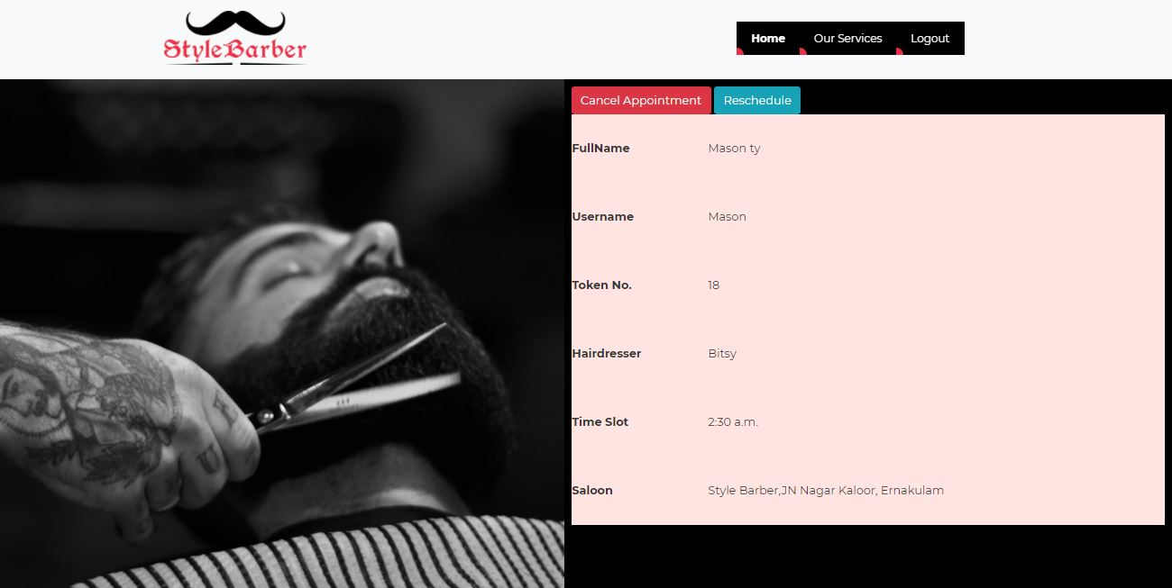

Slide 10
Working of Application
If user needs to reschedule then they can select the available time matching the users availability.

Slide 11
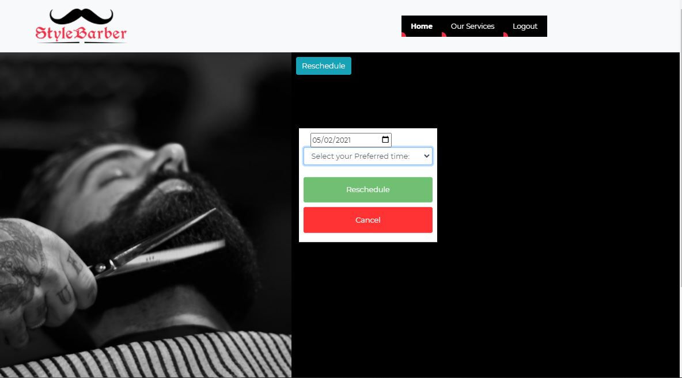

Slide 12
The Admin Controls
The admin has the power to Schedule time based on hairdressers availability.
Each hairdresser can change the status after completing the service.

Slide 13
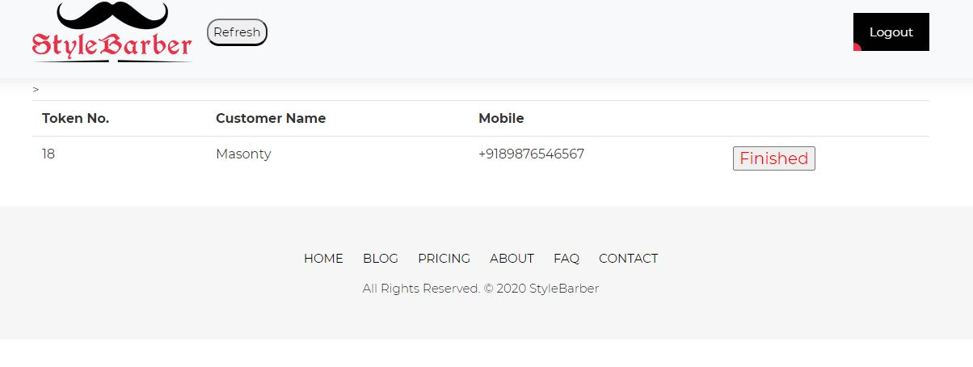
The Admin dashboard
The admin who is provides the service to the customer
can use the button to make the the admins slot available for other customer

Slide 14
Development up to present
The website is hosted on AWS.
The database used is PostgreSQL and the Static files are stored in AWS's S3 Bucket.
The Whatsapp integration was made possible using the Twilio's API for the chat-bot.
The user can now make an appointment and can reschedule with all the features updated.

Slide 15
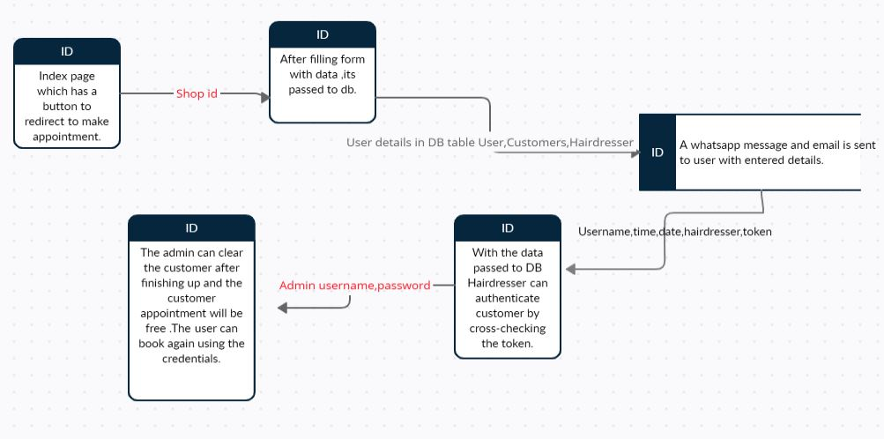
Data Flow

